Slide 1
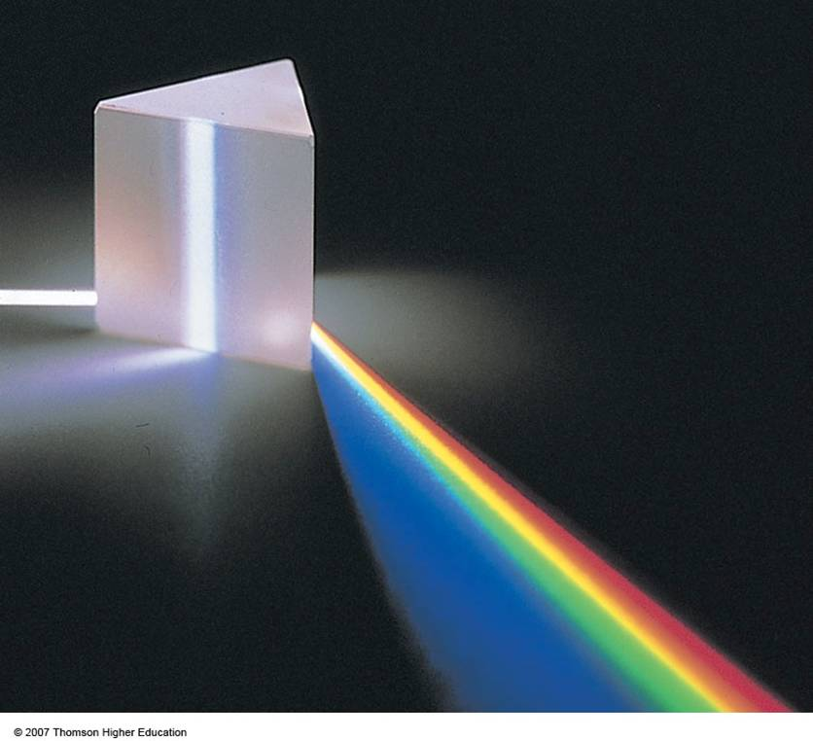
Section 15: The Nature and Propagation of Light

Slide 2
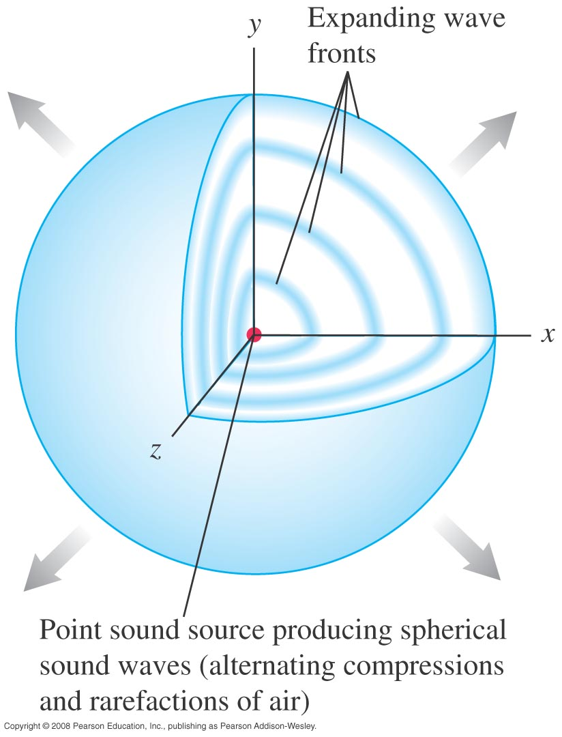
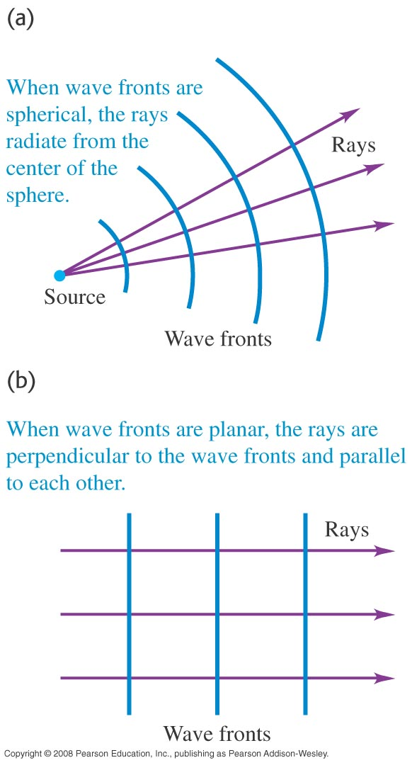
Wave fronts and rays

Slide 3
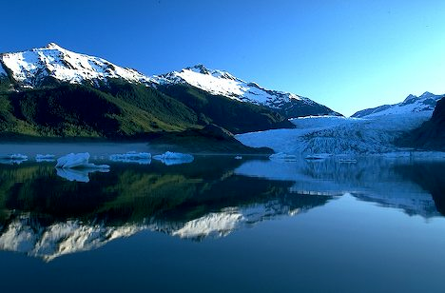
Reflection

Slide 4
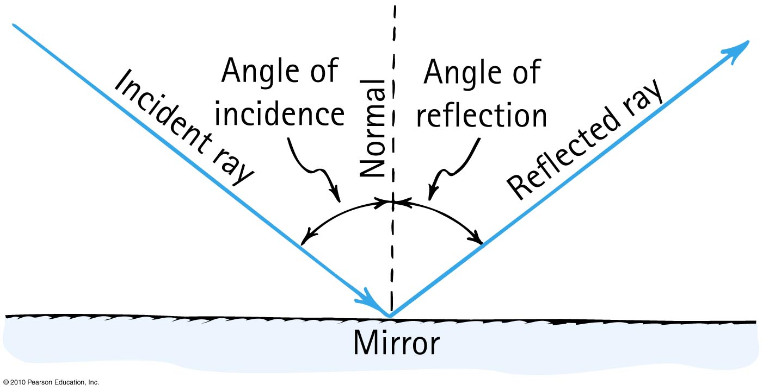
Law of Reflection

Slide 5
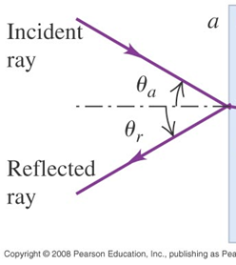

The Law of Reflection
$$θ_{r}=θ_{a}$$

Slide 6
Demo: Lasers and Mirrors

Slide 7
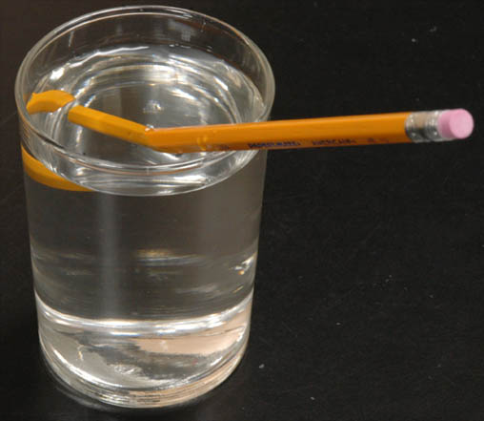
Refraction

Slide 8
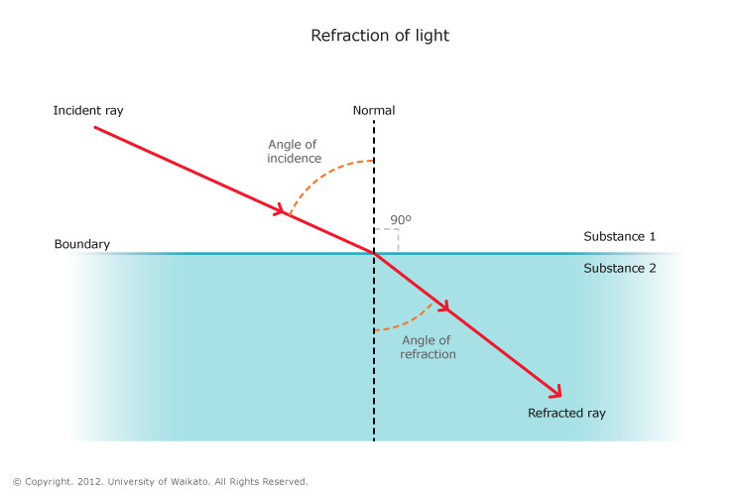
Refraction

Slide 9
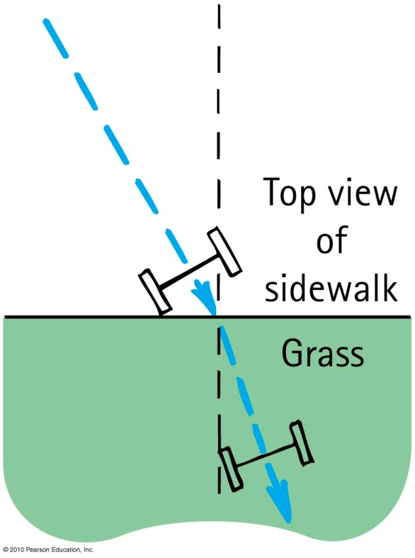
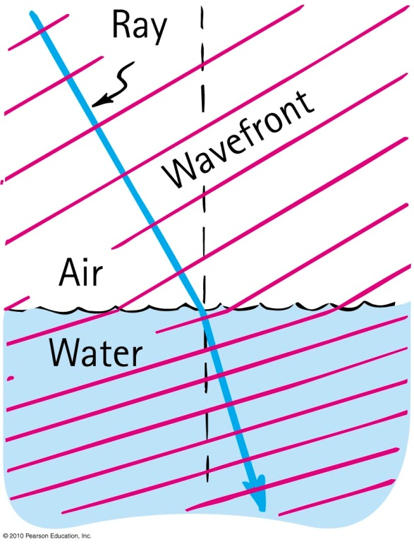
Understanding Refraction: Mud Marching Model

Slide 10
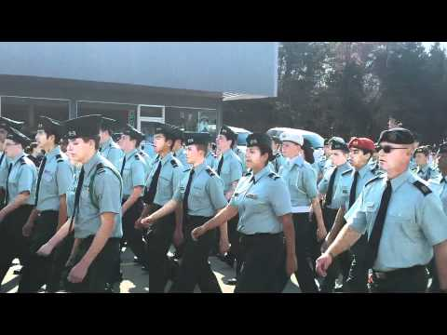
Outside March!!

Slide 11
Demo
Lasers and plastic

Slide 12
Activity: Refraction in a Prism Qualitative

Slide 13
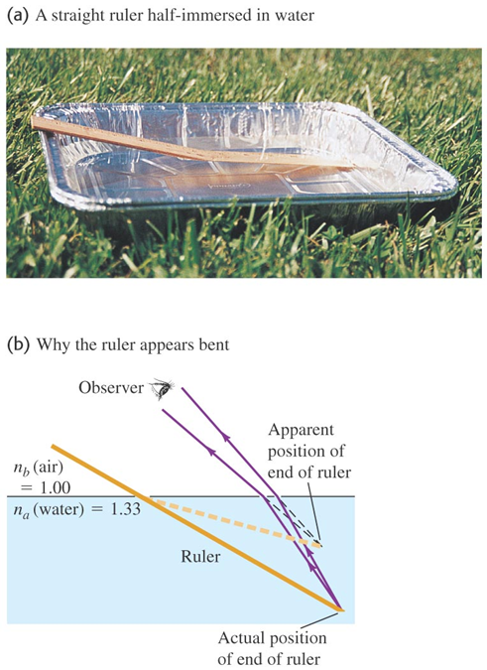
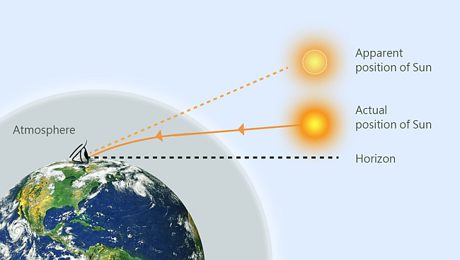
Refraction and Illusions: Objects “Bending” in Water

Slide 14
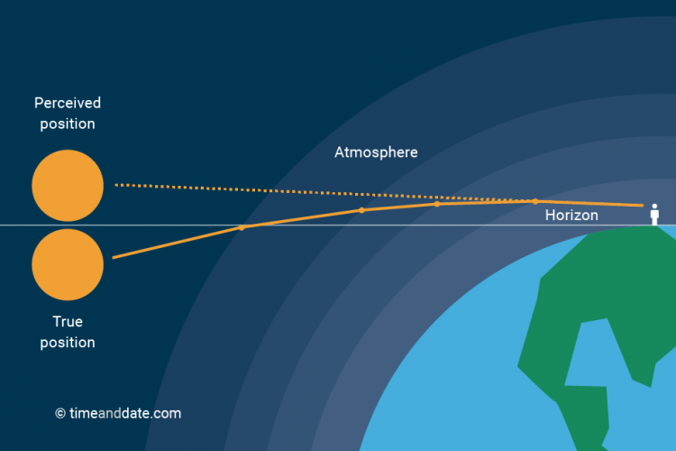
Refraction and Illusions: Sunset

Slide 15
Demo: Coin in Cup

Slide 16
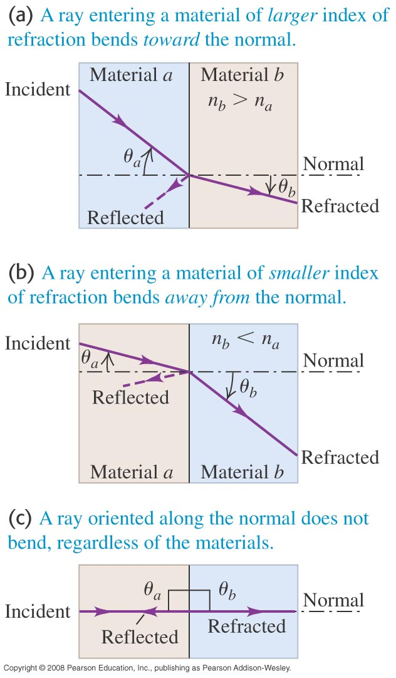

Law of Refraction (Snell’s Law)
$$n_{a}\sin{θ_{a}=}n_{b}\sin{θ_{b}}$$

Slide 17
Activity: Refraction in a Prism Quantitative

Slide 18
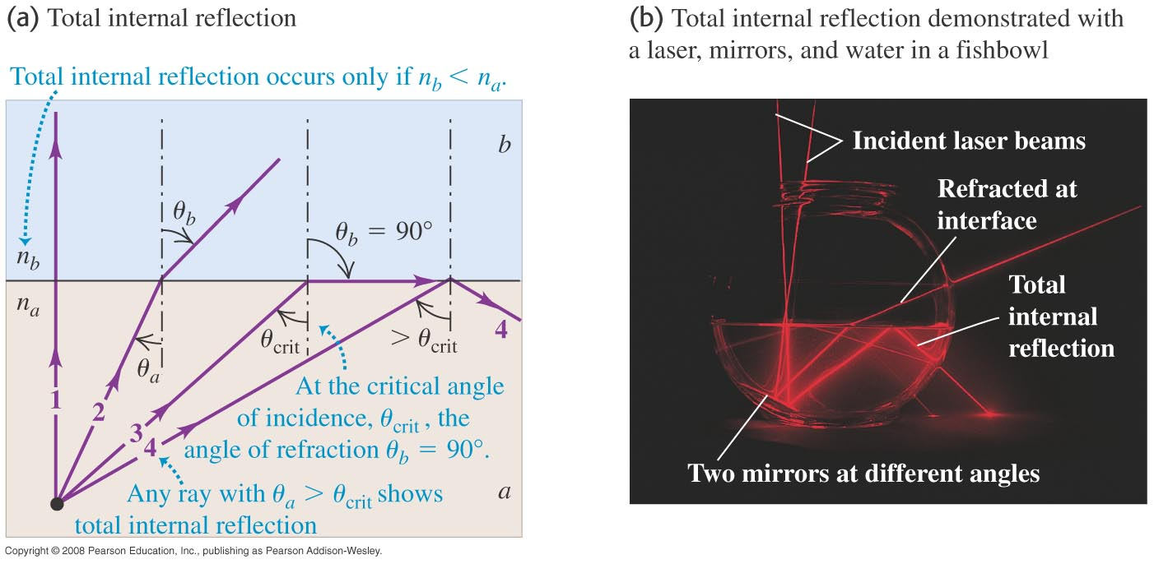
Total internal reflection

Slide 19
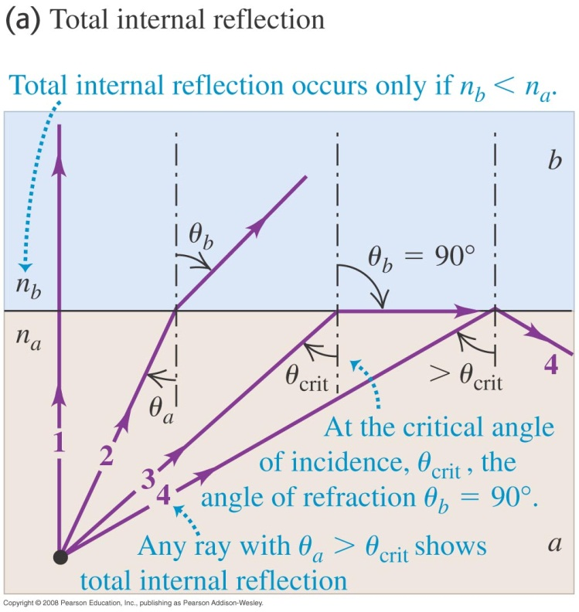

Total Internal Reflection
$\sin{θ_{crit}=\frac{n_{b}}{n_{a}}}$

Slide 20
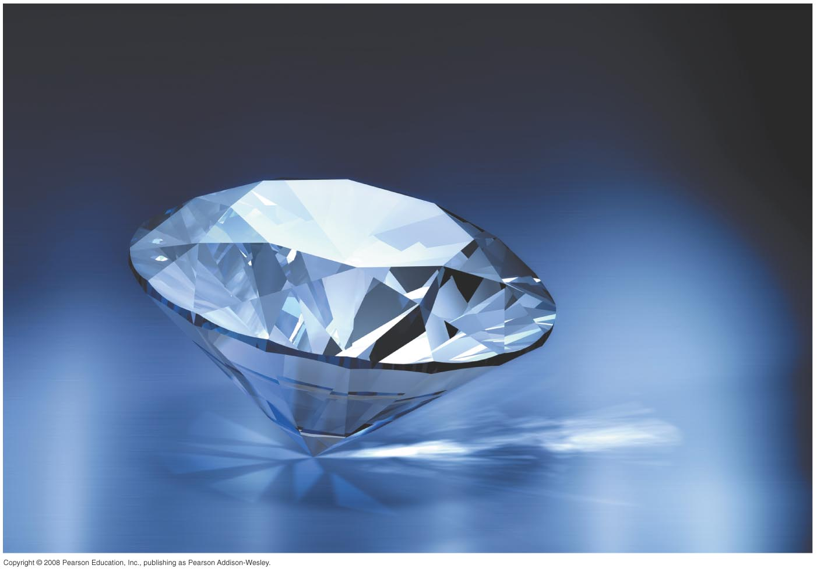
Diamonds and Total Internal Reflection

Slide 21
Demos
Total Internal Reflection
Lasers and optics kit
Lasers and twisted plastic

Slide 22
Activity
A fiber optic cable

Slide 23
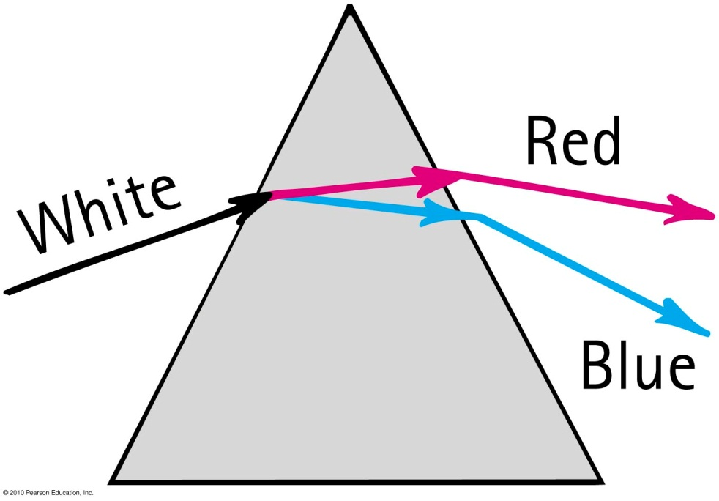
Dispersion
Higher frequencies bend more!!

Slide 24
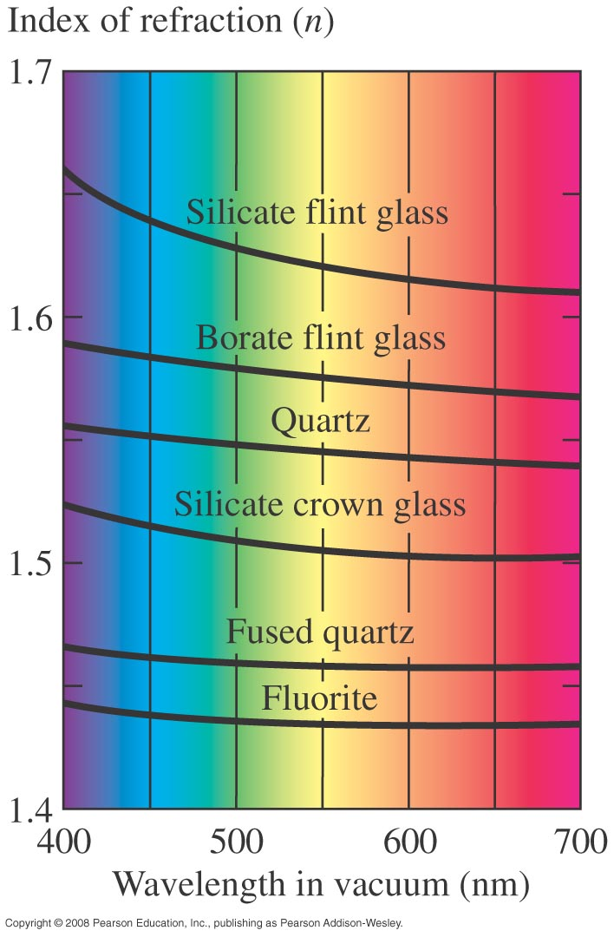
Dispersion

Slide 25
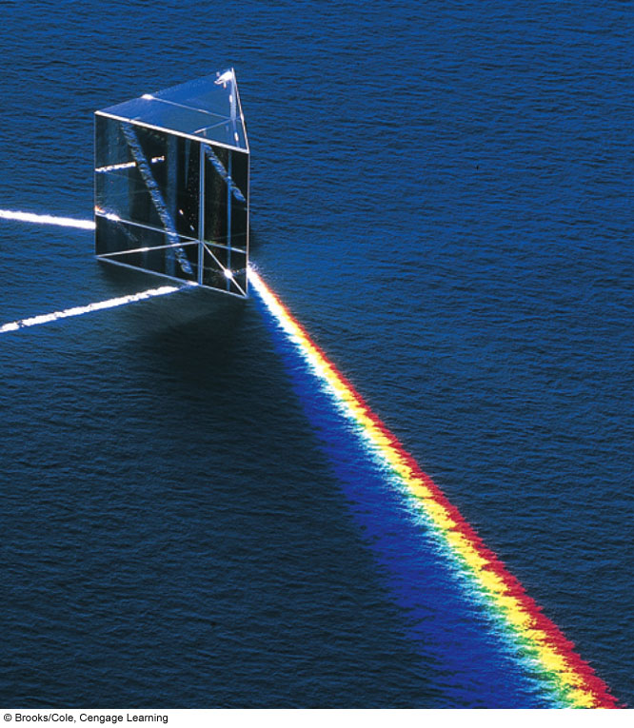
Fig. 22-16b, p. 743
Notes:
Figure 22.16
(b) Different colors of light that pass through a prism are refracted at different angles because the index of refraction of the glass depends on wavelength. Violet light bends the most, red light the least.

Slide 26
Demo: Looking through Prisms

